Slide 1
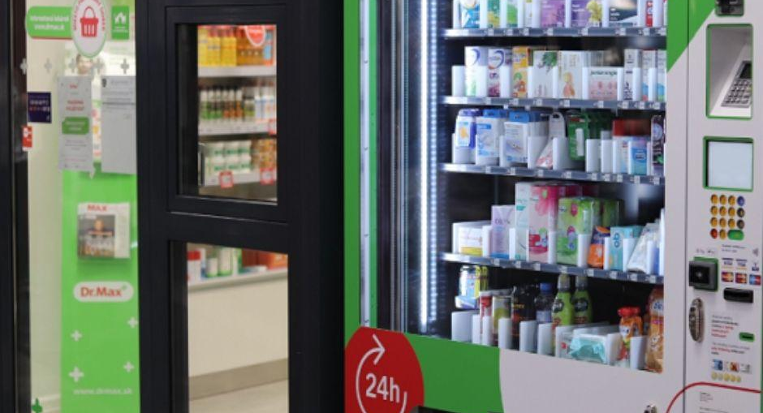
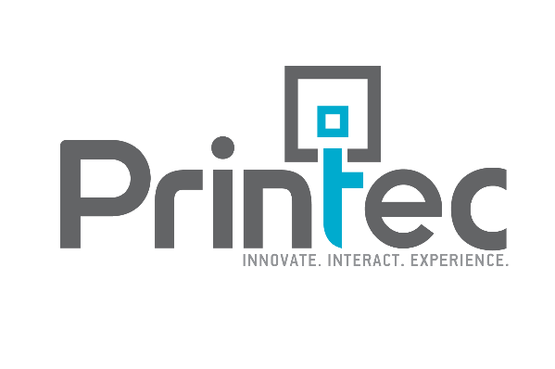
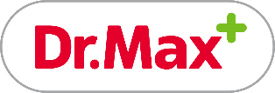
CASE STUDY
24x7 access to pharmaceutical products with smart vending machines
Retail
BY THE NUMBERS
THE CUSTOMER
315
PHARMACIES IN SLOVAKIA
Dr.Max pharmacies were established in 2006 and are currently the market leader in the pharmaceutical business in the Slovak Republic.
Dr.Max operates in 315 locations throughout the country and as an online pharmacy. Dr.Max pharmacies belong to Dr.Max Group, the fourth largest pharmacy group in Europe with more than 2,000 pharmacies in total.
The goal of Dr.Max pharmacies is to offer customers high-quality services and professional advice whenever they need it. Easily accessible locations, availability of medicines and over-the-counter (OTC) products as well as a wide variety of products under the Dr.Max brand are ensured to meet customer expectations and cover their needs.
1,500
EMPLOYEES
15+ m
CUSTOMERS PER YEAR
THE CHALLENGE
5
VENDING MACHINES
Dr.Max identified one key challenge they needed to address so as to future-proof their market position and stand out from the competition; extend the operating time of pharmacies and increase sales.
Dr.Max aimed to offer customers an enhanced experience and ensure 24x7 access to basic pharmaceutical and over-the-counter products for patients. To achieve this, they were looking for an automated solution to improve customer care and product availability while ensuring clients could get a grasp of the added value Dr.Max could bring to them.
xxx
XXXXXXX

Slide 2
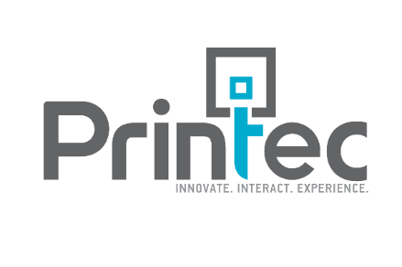
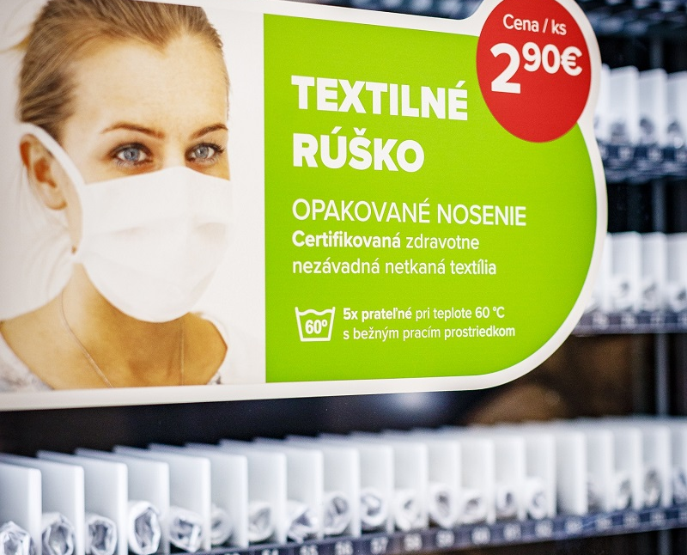
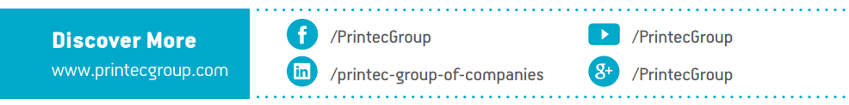

Retail
THE SOLUTION
Printec offered the ideal solution for their challenge: a smart vending machine that could be installed outside the pharmacies to enhance customer experience and ensure round the clock availability.
This also created a competitive advantage for Dr.Max, as it was the first pharmacy to install such machines for pharmaceutical products in Slovakia.
Dr.Max chose Pharmabox mainly because of its ability of temperature control which is critical for medicines; at the same time its vandal proof window with a UV filter secures the safety and storage conditions of the products. The machine also offers both cash and card payments, so customers enjoy a hassle-free checkout experience.
Vending machines during COVID-19 outbreak
To better serve customers during COVID-19 outbreak, Dr.Max equipped the vending machines with masks for repeated use and other essential products, such as hand sanitizers. In that difficult time, Dr.Max was able to secure 24x7 availability of essential goods, while the automated dispensing system ensured maximum protection for customers and reduced the risk of transmitting the virus. Regardless of the day and time customers were able to get their marks, sanitizers and other goods avoiding human contact and were even able to choose the payment method (card or cash).
THE RESULTS
Dr.Max installed 5 vending machines in 3 cities in Slovakia within 10 months.
Now hundreds of Dr.Max customers use smart vending machines on a monthly basis to purchase medicines and OTC products at any time of the day or night.
Key benefits for Dr.Max
Key benefits for customers
Increased sales
Enhanced customer experience
Extended operating time
24x7 access to pharmaceutical products
Ease of use
Ability to pay by card or cash

