Slide 1



CASE STUDY
Transforming through Teller Cash Recyclers: Bank of Cyprus
Finance
THE CUSTOMER
BY THE NUMBERS
Bank of Cyprus Group plays a key role in the growth and success of the economy of Cyprus. It is the largest banking and financial services group in the country with a long and proud history of serving customers in Cyprus since 1899.
The core of BoC Group is driven by its domestic banking business, which is predominantly comprised of Consumer Banking, SME Banking, Corporate Banking, International Banking and Wealth & Markets. The bank is the leading provider of retail banking services in Cyprus.
BoC Group also engages in the provision of insurance through two wholly-owned subsidiaries: EuroLife and GIC.
650,000+
ACTIVE CLIENTS
97
BANK BRANCHES
1,205
BANK EMPLOYEES
THE CHALLENGE
Bank of Cyprus identified two key challenges they needed to address in order to consolidate and future-proof their market position; the changing behavior and demands of customers, and the development of financial regulatory requirements.
Prioritizing these significant challenges required a fresh look at customer experience and the operational processes within the bank branch network.
In 2015, the bank officially started their transformation process for the Retail Banking service, engaging with consultants to plan and implement the necessary changes.
Their ambitious transformation plan included many major changes, such as transferring retail customers to digital and self-service channels, improving customer experience inside the branch, shifting employee focus from dealing with transactions to selling and consulting clients on lifetime events and needs, and finally on improving the operational efficiency and effectiveness of all the procedures performed within the branch.
187
INSTALLED TCRS IN 1 YEAR
100
AVERAGE CASH TRANSACTIONS WITH TCRS PER DAY PER TELLER

Slide 2

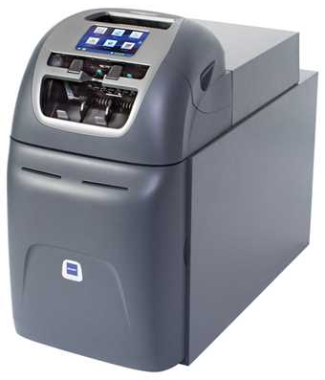


Finance
THE SOLUTION
The in-branch transformation focused on enhancing customer experience and the efficiency and compliance of internal processes.
Bank of Cyprus worked closely with Printec and identified that GLORY’s cash handling technology could address all these requirements. By automating cash handling in branches, the bank was able to free up cashiers to engage more with customers instead of processing cash and increased the operational efficiency and security of transactions within the branch.
The bank selected the GLORY Teller Cash Recycler (TCR) Vertera 6G to enable its bank transformation. As the world leader in TCR solutions in the financial sector, the bank recognized the quality and flexibility of GLORY’s front-line teller technology that is designed to deposit, count, verify, authenticate, secure, dispense and balance currency. With this solution, the bank was able to improve customer and staff experience and ensure the optimization of operational processes.
Vertera 6G | Overview
Ease of use
Large touch screen display
Simple design and intuitive layout
Excellent proven ergonomics
Flexible note storage
Variable capacity
Flexible RSM storage options
Secure Transfer Concept for additional storage of excess notes
High capacity, small footprint
Small footprint and service area
Available in 4, 6 8 RSMs, with up to 4,800 banknotes
Various safe configurations
Intelligent note handling
SDA II for advanced authentication and identification
Low reject rates
Smart counting functionality
Enhanced connectivity and integration
Advanced connectivity options
Legacy interface support
CashInsight Bridge for performance monitoring and remote device management
Future enabled
Easily updated, with CashInsight Bridge
Expandable storage concept
Remote deployment of on-board apps
THE RESULTS
360 cashiers are using 187 TCRs in 78 branches on a daily basis, performing on average 100 transactions per teller per day.
Bank of Cyprus managed to install 187 TCRs in 78 branches in just one year and now more than 360 cashiers are using the machines daily to handle all cash deposits and withdrawals. Currently, the average cash transactions per day are more than 100 per teller, whereas there are peak days (i.e. end of month) that the cash transactions are over 200 per teller.
The efficient connection of the TCRs with the teller transaction systems was of paramount importance for the project’s success.
The bank expects to complete the full roll out within the first quarter of 2020, having installed 200 machines.
Key benefits for the bank:
Streamline the cashier’s processes and therefore manage to save 20 FTEs
Decrease the cash management cost since cash is recycled and used to load the ATMs
Improve customer experience with no cash balances differences
Improve reporting to the Central Bank for cash management
Increase cash branch limits, allowing the bank to further decrease the usage of external security associates

